Slide 1
Intractable Problems
Unit 6

Slide 2
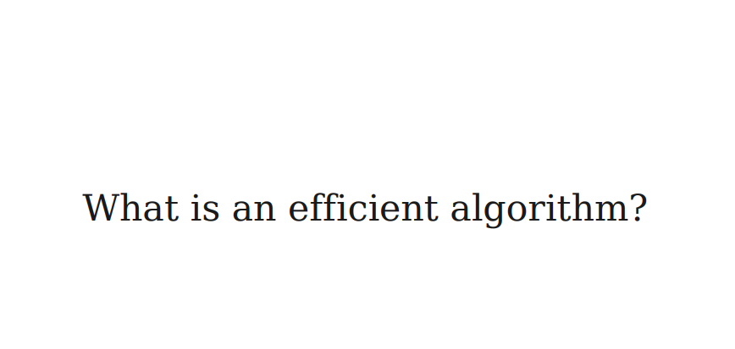

Slide 3
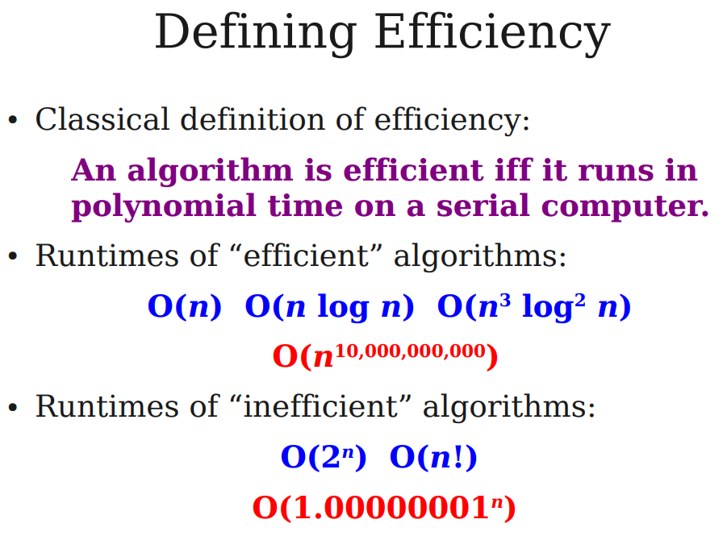

Slide 4
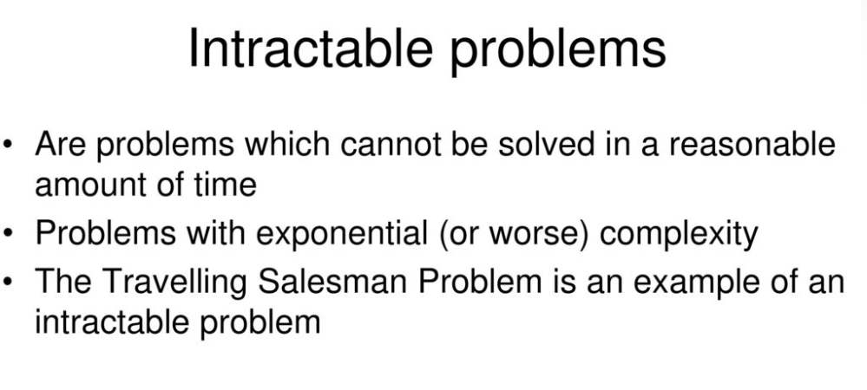

Slide 5
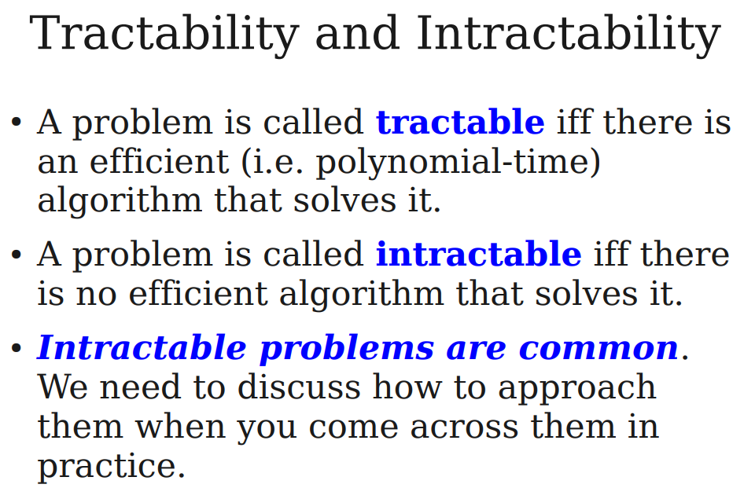

Slide 6
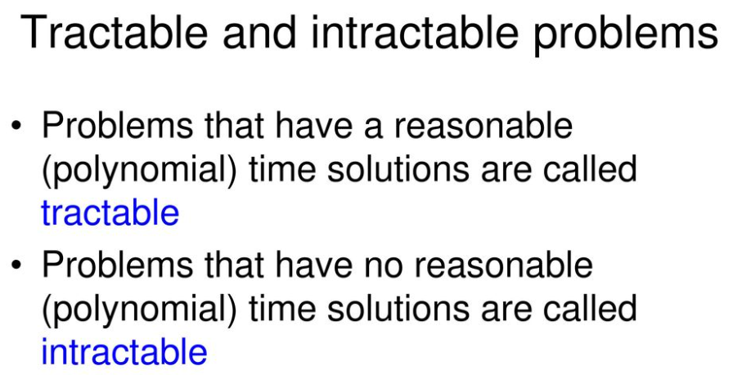

Slide 7
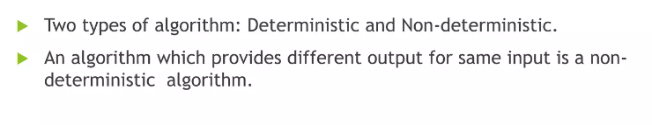
Non-Deterministic Algorithms

Slide 8
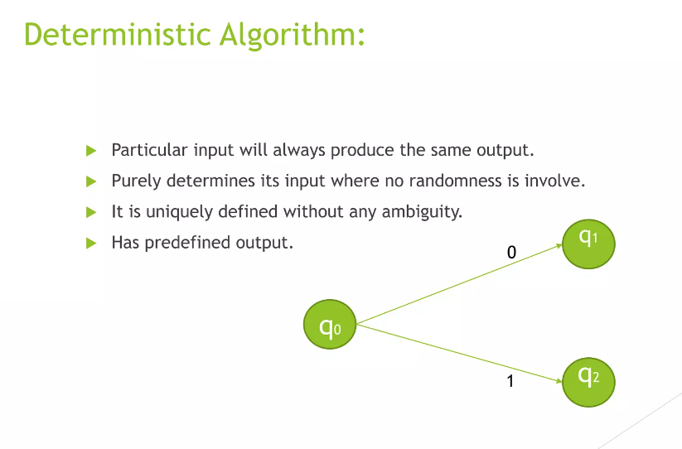

Slide 10
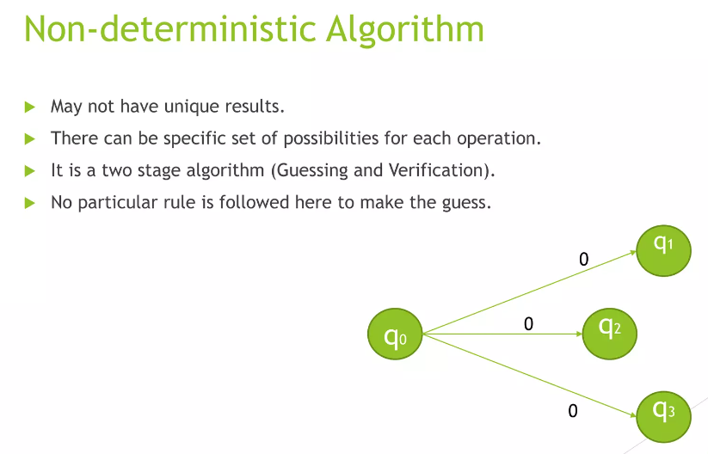

Slide 11
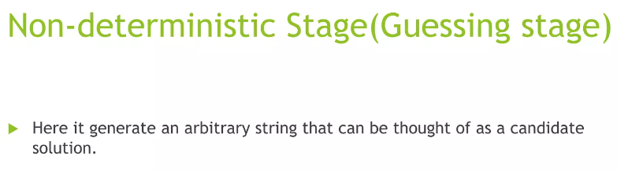
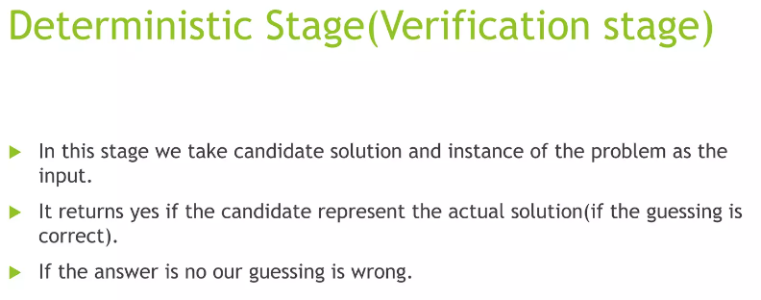

Slide 12
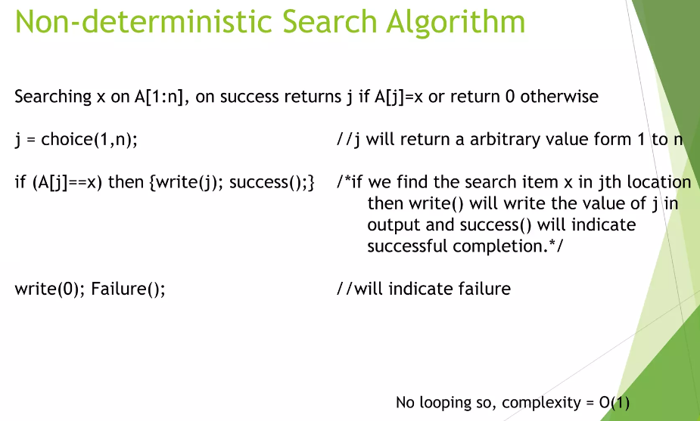

Slide 13
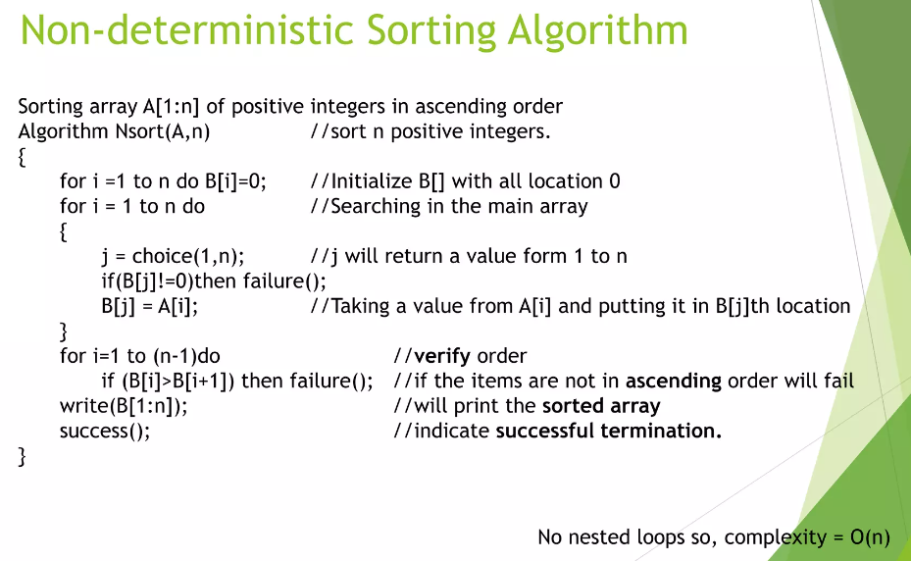

Slide 14
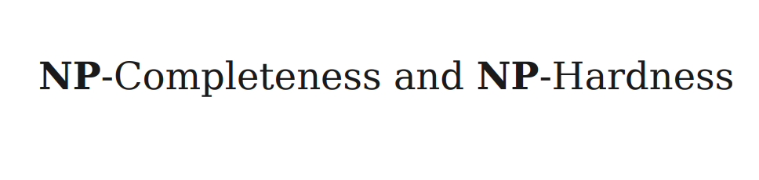

Slide 15
What are NP, P, NP-complete, and NP-Hard problems?
P is a set of problems that can be solved by a deterministic Turing machine in Polynomial-time.
NP is a set of decision problems that can be solved by a Non-deterministic Turing Machine in Polynomial-time.
P is a subset of NP (any problem that can be solved by a deterministic machine in polynomial time can also be solved by a non-deterministic machine in polynomial time).
Informally, NP is a set of decision problems that can be solved by a polynomial-time via a “Lucky Algorithm”, a magical algorithm that always makes a right guess among the given set of choices

Slide 16
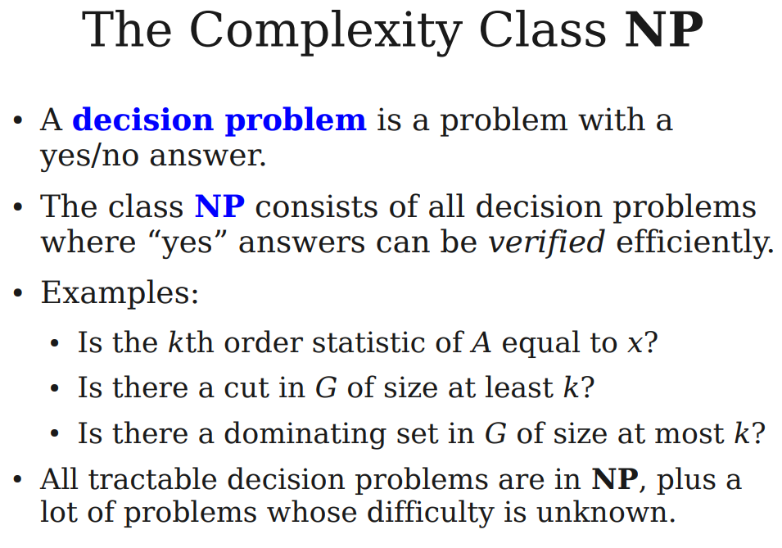

Slide 17
NP-Complete Problems
A problem X is NP-Complete if there is an NP problem Y, such that Y is reducible to X in polynomial time. NP-Complete problems are as hard as NP problems. A problem is NP-Complete if it is a part of both NP and NP-Hard Problem.
NP-complete problems are the hardest problems in the NP set. A decision problem L is NP-complete if:
1) L is in NP (Any given solution for NP-complete problems can be verified quickly, but there is no efficient known solution).
2) Every problem in NP is reducible to L in polynomial time (Reduction is defined below).
Example:
Decision problems.
Regular graphs.

Slide 18
NP-Hard Problems
A problem is NP-Hard if it follows property 2 mentioned previously and doesn’t need to follow property 1. Therefore, the NP-Complete set is also a subset of the NP-Hard set.
A Problem X is NP-Hard if there is an NP-Complete problem Y, such that Y is reducible to X in polynomial time. NP-Hard problems are as hard as NP-Complete problems.
Example :
Hamiltonian cycle .
Optimization problem .
Shortest path

Slide 19
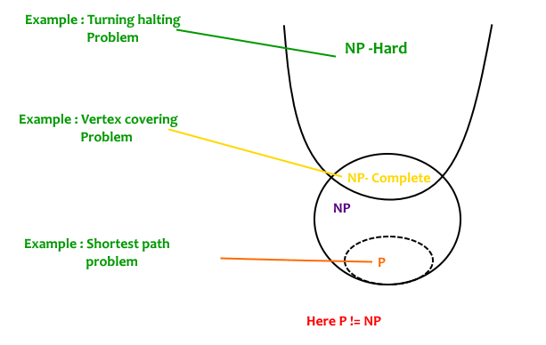
P, NP, NP-Complete and NP-Hard

Slide 20
NP-Hard Problem

Slide 21
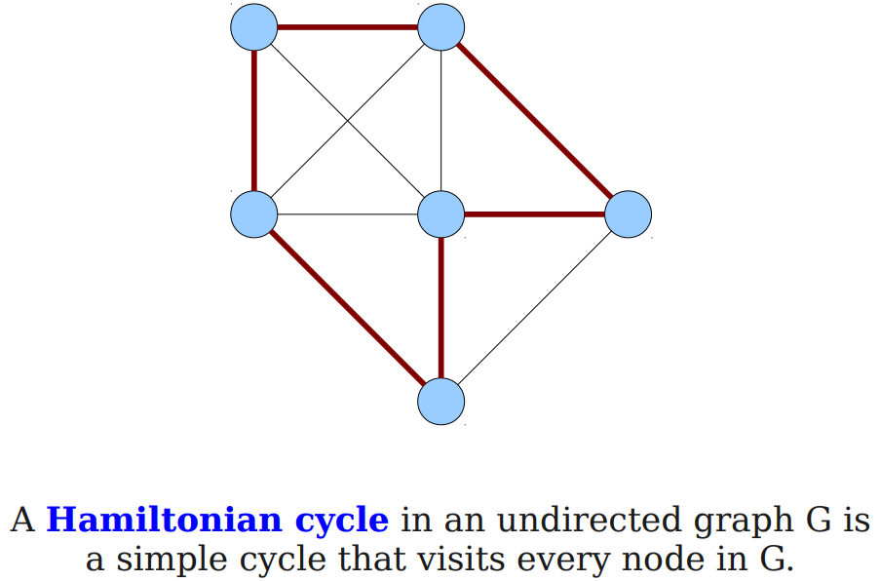

Slide 22
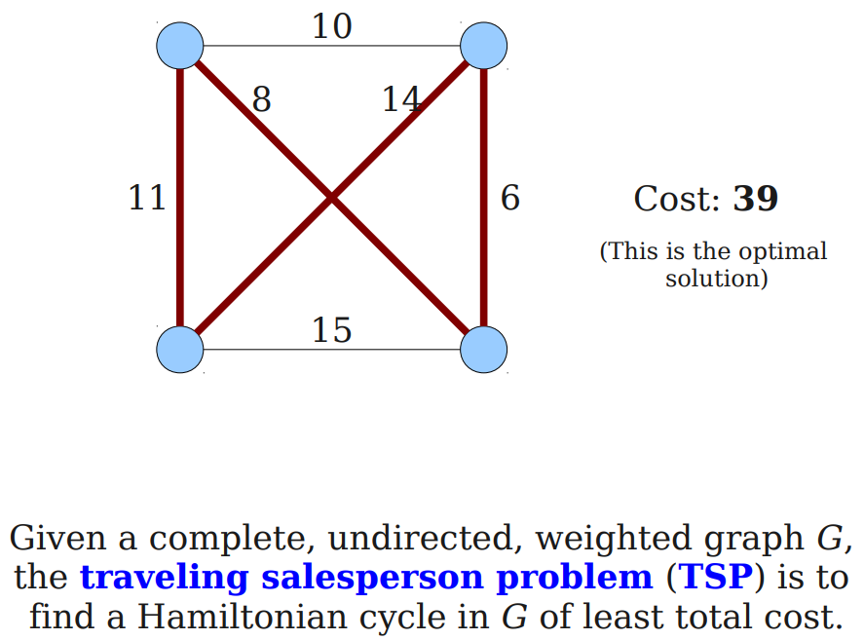

Slide 23
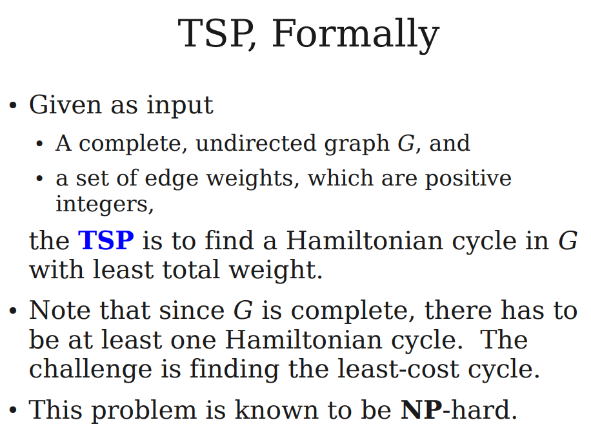

Slide 24
